Slide 1
Virtual scavenger hunt
U.S. Presidential History
MU Student name:
MU email address:

Slide 2

Directions
The objective of this virtual scavenger hunt is to familiarize MU students with a wide variety of information sources.
Topic: Presidential history
Instructions:
Download a copy of this powerpoint presentation
Enter your name and student id# on first page
Find sources to answer questions on each slide. Search engines such as Google may be used to find information. However, a source (e.g. Wikipedia) can only be used once.
Take a screen shot or snip of the answer and paste on slide. Use text to provide additional details if required.
Save document and email to edubicki@monmouth.edu

Slide 3
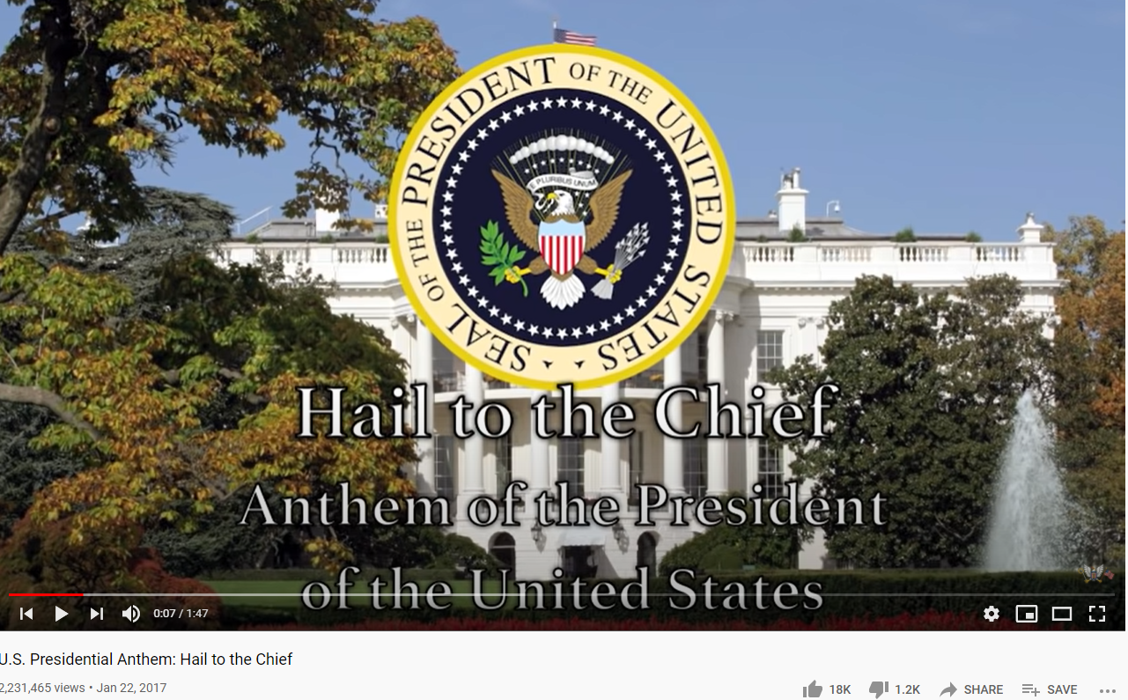
What song is played to announce the arrival of the President?
Example
Screen shot:
Music

Slide 4
What was the location and date of the meeting of the First Continental Congress?
Screen shot:
Website

Slide 5
What is the first line of the U.S. Constitution?
Screen shot:
Government Archives

Slide 6
Find an book about Franklin D. Roosevelt
Screen shot:
Book

Slide 7
Find a newspaper photo of the 2008 Presidential inauguration
Screen shot:
Newspaper

Slide 8
Find an article about the Bay of Pigs invasion
Screen shot:
Google Scholar

Slide 9
Locate a sculpture of a U.S. President
(location & image)
Screen shot:
Sculpture

Slide 10
Locate a presidential library
(location & image)
Screen shot:
Website

Slide 11
Find a portrait of Abraham Lincoln
(list artist & image)
Screen shot:
Art

Slide 12
Locate a trail map for Mt. Rushmore National Memorial
Screen shot:
Website

Slide 13
Find a movie or documentary about a president
Screen shot:
Video

Slide 14
You have now collected information from a wide variety of sources.
Scholarly articles are usually peer-reviewed by experts in the field for accuracy.
Other sources should be evaluated carefully. Try to verify information in other sources. Some considerations:
- Currency
- Relevance
- Authority
- Accuracy
- Purpose
Last step: Save a copy of this slide presentation and send to: edubicki@monmouth.edu
Congratulations on completing the scavenger hunt!

